Slide 1
UTSHOB
Mission Statements:
The Utshob charity organization partners with Bangladeshi and other communities using a holistic, sustainable development model that equips poor children with the tools and skills they need to lift themselves out of poverty. We highly value giving them the opportunity to become contributing members of the community.
We are committed to a culture of responsibility, dignity, and leading our community to promote and preserve our culture and language through social awareness. We accomplish this by providing a platform that acts as a catalyst to bring positive changes.

Slide 2
Our VISION
Provide scholarship assistance to financially challenged but academically brilliant students
Provide free food and shelter to the poor, orphanage and homeless communities
Provide a sustainable charity model when appropriate.
Encourage communication and collaboration among similar minded organizations serving Bangladesh and US communities.

Slide 3
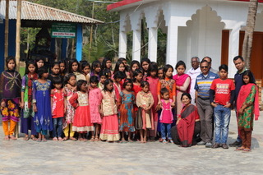
Manab kalyankami anathalaya(orphangae), NETROKONA, BANGLADESH
UTSHOB was considering some target based charitable activities that will self-sustain over the years. This orphanage is located at Netrokona, Bangladesh has 112 orphan students. The Ashram was looking some monetary support and directives. UTSHOB contributed money to purchase two Australian Cows for the Ashram. Selling milk from these cows helps the orphanage to support up to 5 student’s expenses and their nutrition. Our future goal also to support these students current education, their accommodation, as well as mentoring them to choose right path in their career. UTSHOB is considering to expand this project to the next level by providing direct scholarships to some of the students going higher for education.

Slide 4
Manab kalyankami anathalaya(orphangae), NETROKONA, BANGLADESH
Funds spent: US$2,740 to buy an Australian cow with a calf.
Objective: To establish a dairy firm which will act as a self-sustaining model for income source for the orphanage and as well as it will train students and will help to develop responsibilities.
Future goals:
Establish a plan to guide these students after they leave the Orphanage and enter job market.
To establish a telemedicine center which will provide primary care services including diabetic center, hypertension center and specialty consultation and guidance. Utshob has a plan to establish a state of art medical clinic including basic labs facility in near future.

Slide 5
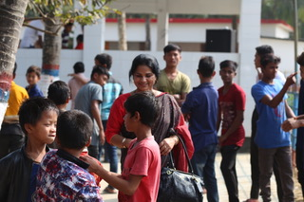
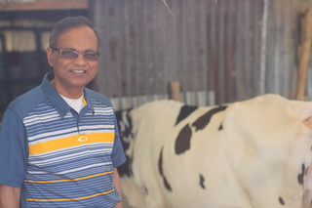
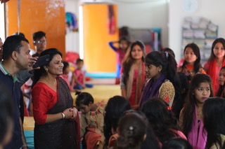
Nayan yOGI’s ORPHANAGE ASHRAM, NETROKONA, BANGLADESH
UTSHOB member Reba Paul vising children at Ashram
UTSHOB’s President Dr. Probir Paul vising cows at Ashram’s Dairy Farm project
TIMELINE: FEB. 2019
UTSHOB’s President and Executive members Dr. Probir Paul and Dr. Sajib Saha vising Children at Ashram
UTSHOB’s member and executive members Reba Paul Dr. Sajib Saha responding questions of the Children at Ashram

Slide 6
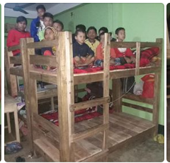
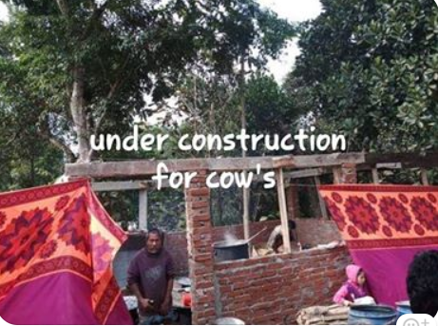
VIbaKANAnDA anathalaya (orphanage), KHAGRACHARI, BANGLADESH
UTSHOB was considering some target based charitable activities that will self-sustain over the years. Swami Vivekananda's orphanage Ashram at Khagrachari, Bangladesh has land, limited resources to maintain the charitable activities. This Ashram has 20 orphan students. The Ashram was looking some monetary support and directives. UTSHOB contributed money to purchase 10 bunk beds, study desks, dining tables for these students, and help to construct a shade for cows and purchased two Australian cows.

Slide 7
SWAMI VIVEKANADA ORPHANAGE ASHRAM, KHAGRACHARI, BANGLADESH
Funds spent: US$2,200 to buy 10 bunk beds and build a place for cows.
Objective: To establish a dairy firm which will act as a self-sustaining model for income source for the orphanage and as well as it will train students and will help to develop responsibilities.
Future goals:
Establish a plan to guide these students after they leave the Orphanage and enter job market.

Slide 8
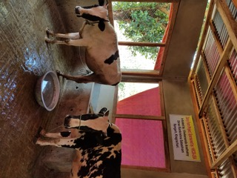
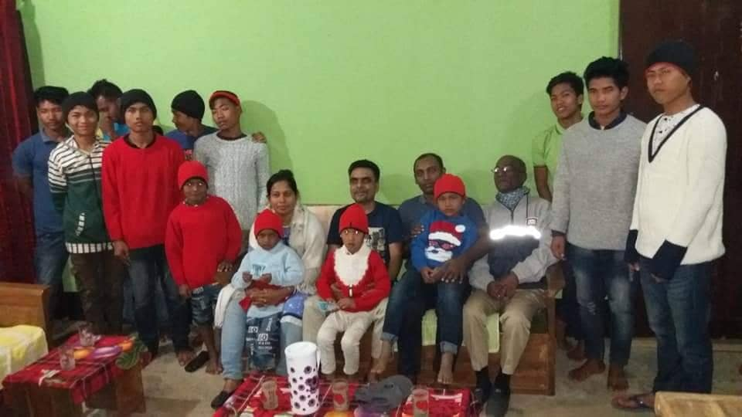
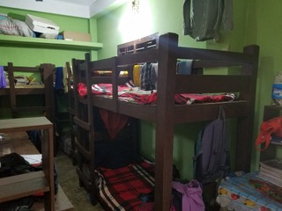
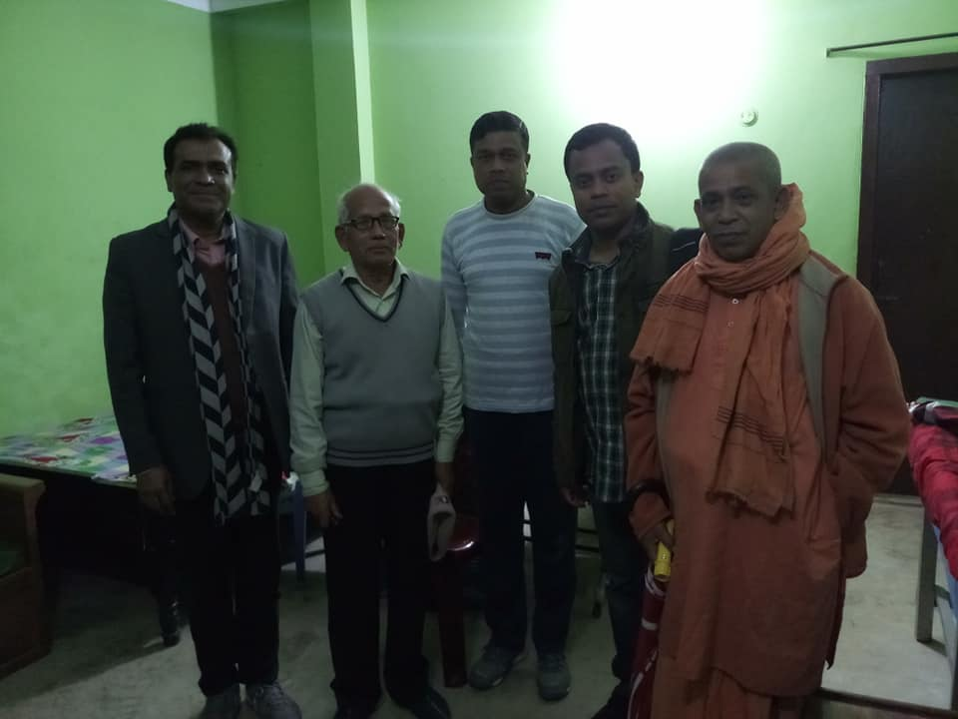
VIVEKANANDA ORPHANAGE ASHRAM, CHITTAGONG, BANGLADESH
Utshob bought cows for Ashram’s Dairy Farm project
children at Ashram
TIMELINE: FEB. 2019
UTSHOB’s donated 10 Bunk beds for Ashram’s 20 students
UTSHOB’s executive members Dr. Sajib Saha visiting Ashram members

